Slide 1
Ethanol: From then to now
Unit 1, Lesson 3

Slide 2
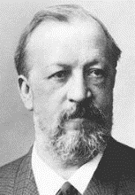
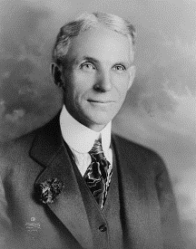
History of Ethanol
1826 Samuel Morey developed an engine that ran on ethanol and turpentine.
1860 German engine inventor Nicholas Otto used ethanol as the fuel in one of his engines.
1862 The Union Congress put a $2 per gallon excise tax on ethanol to help pay for the Civil War. Prior to the Civil War, ethanol was playing a major role in eliminating oil in the United States. After the tax was imposed, ethanol cost too much to be used this way.
1896 Henry Ford built his first automobile, the quadricycle, to run on pure ethanol.
1906 More than 50 years after imposing the tax on ethanol, Congress removed it, making ethanol an alternative to gasoline as a motor fuel.
1908 Henry Ford produced the Model T. As a flexible fuel vehicle, it could run on ethanol, gasoline or a combination of the two.
1917 - 1918 The need for fuel during World War I drove up ethanol demand to 50-60 million gallons per year.
1920’s Gasoline became the motor fuel of choice. Standard Oil began adding ethanol to gasoline to increase octane and reduce engine knocking.

Slide 3
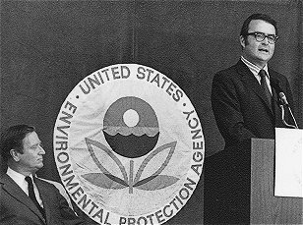
History of Ethanol
1930’s Fuel ethanol gained a market in the Midwest. More than 2,000 gasoline stations in the Midwest sold gasohol, which was gasoline blended with between 6 percent and 12 percent ethanol.
1941-1945 Ethanol production for fuel use increased, due to a massive wartime increase in demand for fuel, but most of the increased demand for ethanol was for non-fuel wartime uses.
1945-1978 Once World War II ended, with reduced need for war materials and with the low price of fuel, ethanol use as a fuel was drastically reduced. From the late 1940s until the late 1970s, virtually no commercial fuel ethanol was available anywhere in the U.S.
1974 The first of many legislative actions to promote ethanol as a fuel, the Solar Energy Research, Development, and Demonstration Act led to research and development of the conversion of cellulose and other organic materials (including wastes) into useful energy or fuels. To this day, there is still not a commercial plant using cellulose as the feedstock.
1975 U.S. begins to phase out lead in gasoline. Ethanol becomes more attractive as a possible octane booster for gasoline. The Environmental Protection Agency (EPA) issued the initial regulations requiring reduced levels of lead in gasoline in early 1973. By 1986 no lead was to be allowed in motor gasoline.

Slide 4
History of Ethanol
1978 The first time gasohol was defined, it was in the Energy Tax Act. Gasohol was a blend of gasoline with at least 10 percent alcohol by volume, excluding alcohol made from petroleum, natural gas or coal. All ethanol to be blended into gasoline is produced from renewable biomass feed stocks. The Federal excise tax on gasoline at the time was 4 cents per gallon. This law amounted to 40 cents per gallon subsidy for every gallon of ethanol blended into gasoline.
1979 - Marketing of commercial alcohol-blended fuels began with Amoco Oil Company. Followed by Ashland, Chevron, Beacon and Texaco. About $1 billion went to biomass projects from Interior and Related Agencies Appropriation Act.
1980 - 1984 - U.S. survey of ethanol production was conducted. Fewer than 10 ethanol facilities existed, producing approximately 50 million gallons of ethanol per year. Congress enacted a series of tax benefits to ethanol producers and blenders. These benefits encouraged the growth of ethanol production.
1980 - The Energy Security Act offered loans for small ethanol producers (less than 1 million gallons/year), up to $1 million in loan guarantees per project that could cover up to 90 percent of construction costs on an ethanol plant, price guarantees for biomass energy projects, and purchase agreements for biomass energy used by federal agencies.
1980 - Congress placed an import fee (tariff) on foreign-produced ethanol. Previously, foreign producers, such as Brazil, were able to ship less expensive ethanol into the United States.

Slide 5
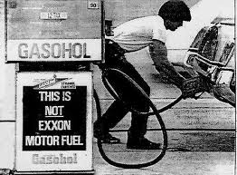
History of Ethanol
1980 - The Gasohol Competition Act banned retaliation against ethanol resellers.
1980 - The Crude Windfall Tax Act extended the ethanol-gasoline blend tax credit.
1983 The Surface Transportation Assistance Act increased the ethanol subsidy to 50 cents per gallon.
1984 The number of ethanol plants in the U.S. peaked at 163. The Tax Reform Act increased the ethanol subsidy to 60 cents per gallon.
1985 Many ethanol producers went out of business, despite the 60 cents/gallon subsidy. Only 74 of the 163 commercial ethanol plants remained operating by the end of 1985, producing 595 million gallons of ethanol for the year. Despite the low price of corn, the main driver of the cost of producing ethanol.
1988 The first oxygenate used in gasoline was ethanol. Denver, CO, mandated oxygenated fuels for winter use to control carbon monoxide emissions. Other oxygenates added to gasoline included Methyl Tertiary Butyl Ether - made from natural gas and petroleum and Ethyl Tertiary Butyl Ether - made from ethanol and petroleum.

Slide 6
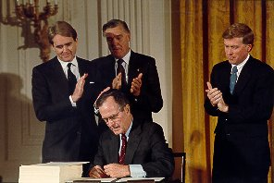
History of Ethanol
1990 Omnibus Budget Reconciliation Act decreased the ethanol subsidy to 54 cents per gallon of ethanol. Ethanol plants began switching from coal to natural gas for power generation and adopting other cost-reducing technologies.
1992 The Energy Policy Act of 1992 (EPACT) provided for two additional gasoline blends (7.7% and 5.7% ethanol). EPACT also defined ethanol blends with at least 85% ethanol as “alternative transportation fuels.” It also required specified car fleets to begin purchasing alternative fuel vehicles, such as vehicles capable of operating on E-85 (a blend of 85% ethanol and 15% gasoline). The EPACT also provided tax deductions for purchasing (or converting) a vehicle to that could use an alternative fuel such as E-85 and for installing equipment to dispense alternative fuels. The Clean Air Act Amendments mandated the winter-time use of oxygenated fuels in 39 major carbon monoxide non-attainment areas (areas where EPA emissions standards for carbon monoxide had not been met) and required year-round use of oxygenates in 9 severe ozone non-attainment areas in 1995. MTBE was still the primary oxygenate used in the U.S.
1995 The excise tax exemption and income tax credits were extended to ethanol blenders producing ETBE. The EPA began requiring the use of reformulated gasoline year round in metropolitan areas with the most smog.

Slide 7
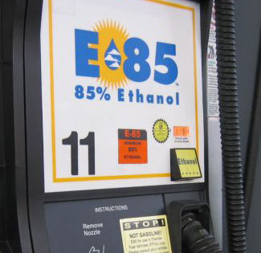
History of Ethanol
1995 - 1996 With a poor corn crop and the doubling of corn prices in the mid-1990s to $5 a bushel, some states passed subsidies to keep the ethanol industry solvent.
1997 Major U.S. auto manufacturers began mass production of flexible-fueled vehicle models capable of operating on E-85, gasoline, or both. Despite their ability to use E-85, most of these vehicles used gasoline as their only fuel because of the scarcity of E-85 stations.
1998 The ethanol subsidy is extended through 2007 but will be gradually reduced. The ethanol subsidy of 54 cents per gallon will be reduced gradually to 51 cents per gallon in 2005.
1999 Some states began to pass bans on MTBE use in motor gasoline because traces of it were showing up in drinking water sources, from leaking gasoline storage tanks. Because ethanol and ETBE are the main alternatives to MTBE as an oxygenate in gasoline, bans will increase the need for ethanol.
2000 EPA recommended that MTBE should be phased out nationally.
2001 Ethanol subsidy was reduced to 53 cents per gallon starting January 1, 2001.

Slide 8
History of Ethanol
2002 U.S. automakers produced large numbers of E-85-capable vehicles to meet federal regulations that require a certain percentage of fleet vehicles capable of running on alternative fuels. More than 3 million of these vehicles were in use. Several states were encouraging fueling stations to sell E-85. With only 169 stations in the U.S. selling E-85, most are still operating on gasoline instead of E-85.
October 2003, a total of 18 states had passed legislation that will ban MTBE - but none of the states that are major users of MTBE, such as Calif., Conn., Ky., Mo., and N.Y. MTBE is the technology to make ethanol from sugar and corn predates the automobile.
2005 The Energy Policy Act of 2005, written by the EPA contains regulations to ensure that gasoline sold in the United States contains a minimum volume of renewable fuel.
September 2006 The Renewable Fuel Standard Program (RFS) is signed. This national renewable fuel program is designed to encourage the blending of renewable fuels (ethanol) into our nation's motor vehicle fuel. The nationwide Renewable Fuels Standard (RFS) will double the use of ethanol and biodiesel by 2012.

Slide 9
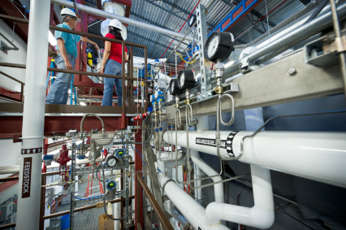
History of Ethanol
December 2007 Energy Independence and Security Act signed by Congress and the President, which requires the use of 15 billion gallons of renewable (ethanol) fuel by 2015. In 2007 about 6.5 billion gallons were produced.
2007-2008 Surge in individual states mandating the use of 10% ethanol E10 gasoline. Rapid increase in documented engine problems, and lawsuits related to E10 blends of gasoline.
2010 - Amendments to the Petroleum Marketing Practices Act make it unlawful to prohibit installation of E-85 or B-20 tanks and pumps.

Slide 10
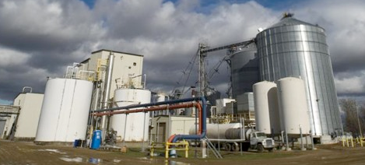
History of Ethanol
2010 – Each federal agency is required to install at least one renewable fuel pump at each federal fleet refueling center to help build infrastructure.
2012 – Amendments to the Energy Policy Act of 2005 require research on energy efficiency and cellulosic ethanol at biorefineries. It also requires the establishment of 7 bioresearch centers focused on biofuels.
2012 – Energy Department testing showed no significant loss of vehicle performance (emissions, fuel economy, and maintenance issues) with E10, E15, or E20 blends.

Slide 11
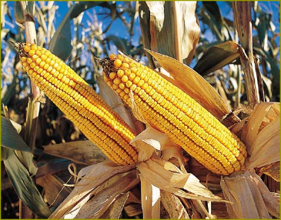
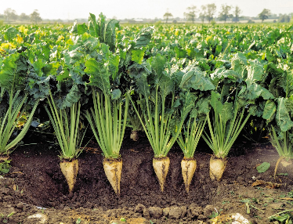
Importance of Ethanol
Corn is the main feedstock for ethanol in the United States - abundant and cheap.
The starch in the corn is first turned into sugar, then fermented into alcohol.
Sugar cane and sugar beets feed stocks are more frequently used.
Sugar crops are the easiest to convert into alcohol.
Brazil is the country with the world's largest ethanol production because of abundant sugar cane.

Slide 12
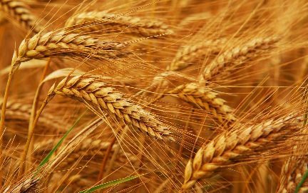
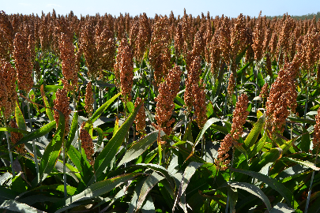
Importance of Ethanol
Other crops or wastes from food or beverage processes are used as the feedstock at some ethanol plants. These feed stocks include wheat, milo (or sorghum), potatoes, and beverage wastes.
Ethanol production can use corn in a wet or dry mill process or use the stalks for cellulosic ethanol.

Slide 13
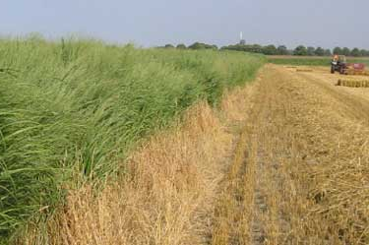
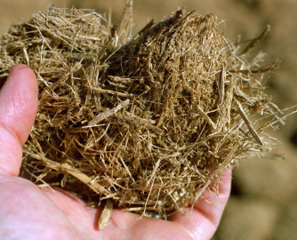
Importance of Ethanol
Ethanol plants continue to be built throughout the Midwest and Corn Belt where supplies are abundant and resources allow.
Cellulosic ethanol is a more complex and costly process. But there have been a lot of improvements.
Cellulosic ethanol feedstocks may include:
Corn stover
Rice straw
Switchgrass
Trees / wood chips
Bagasse
Sweet/forage sorghum

